Slide 1
SIMULATION APPROACH TO EVALUATE ELECTRIC VEHICLE ROUTES WITH TIME WINDOWS
Sumanth Meela
MS Thesis defense
Industrial and Systems Engineering

Slide 2
Introduction
The transportation sector is the single largest contributor to greenhouse gas emissions in the United States, accounting for 29% of total emissions.
In response to growing climate concerns and regulatory pressure, major logistics companies such as Amazon, FedEx, UPS, and Linde have begun transitioning their delivery fleets to Electric Vehicles (EVs).
Why Electric Vehicle:
Lower Operating Costs: Significant savings from reduced fuel consumption and fewer mechanical repairs.
Environmental Impact: EVs produce zero tailpipe emissions, contributing directly to carbon footprint reduction.
Sustainability Alignment: Helps organizations meet broader national/international climate goals.
But transitioning isn't enough; Operational challenges must be addressed.

Slide 3
The Problem – Real-World Routing Challenges
Route planning for EVs is more complex than traditional vehicles.
Battery range is highly sensitive to:
Payload weight
Terrain (slopes, hills)
Wind speed & temperature (especially in cold cities like Buffalo)
Driving behavior (e.g., aggressive acceleration)
Manufacturer-provided range estimates often don’t reflect real-world conditions
This study focuses on:
Validating expert-planned routes under real driving conditions.
Ensuring on-time delivery and charging stops when the battery drops below 30%.
Improving the reliability of EV delivery operations in challenging climates

Slide 4
What Previous Research Has Accomplished
Developed electric vehicle routing models with time windows and recharging stops
Introduced dynamic charging durations based on remaining battery
Assumed constant energy consumption per distance traveled for simplification.
Considered factors like:
Driving behavior
Road slope/topography
Payload
Traffic conditions
Temperature extremes (hot/cold)
Proposed scalable optimization algorithms for mixed fleets and large-scale networks.
Identified charging station delays as a source of delivery uncertainty.

Slide 5
What Our Work Adds to the Literature
Incorporates wind speed — a major but often ignored factor in battery depletion.
Evaluates real-world delivery feasibility against planned routes.
Checks whether customer time windows are actually being met.
Assesses performance in cold weather conditions (e.g., Buffalo winters).
Recharging restrictions to maximize EV battery life, implying a minimum charge of 20% and a maximum charge of 80%, which reduces the EV range substantially.
Combines multiple real-time variables:
Wind
Speed
Payload
Temperature
Moves beyond static modeling to validate expert-designed routes under real constraints

Slide 6
Preparation of the data
Customer Delivery Network
The delivery network is situated in Buffalo, NY, a city known for its extreme winters, which poses significant challenges for electric vehicle (EV) operations.
Customers span across diverse industries, including:
Healthcare – delivery of critical medical gases like oxygen
Manufacturing & Metals – support for welding and industrial processes
Food & Beverage – use of CO₂ and nitrogen for freezing and packaging
These industries require time-sensitive and reliable deliveries, increasing the importance of precise route and energy planning.

Slide 7
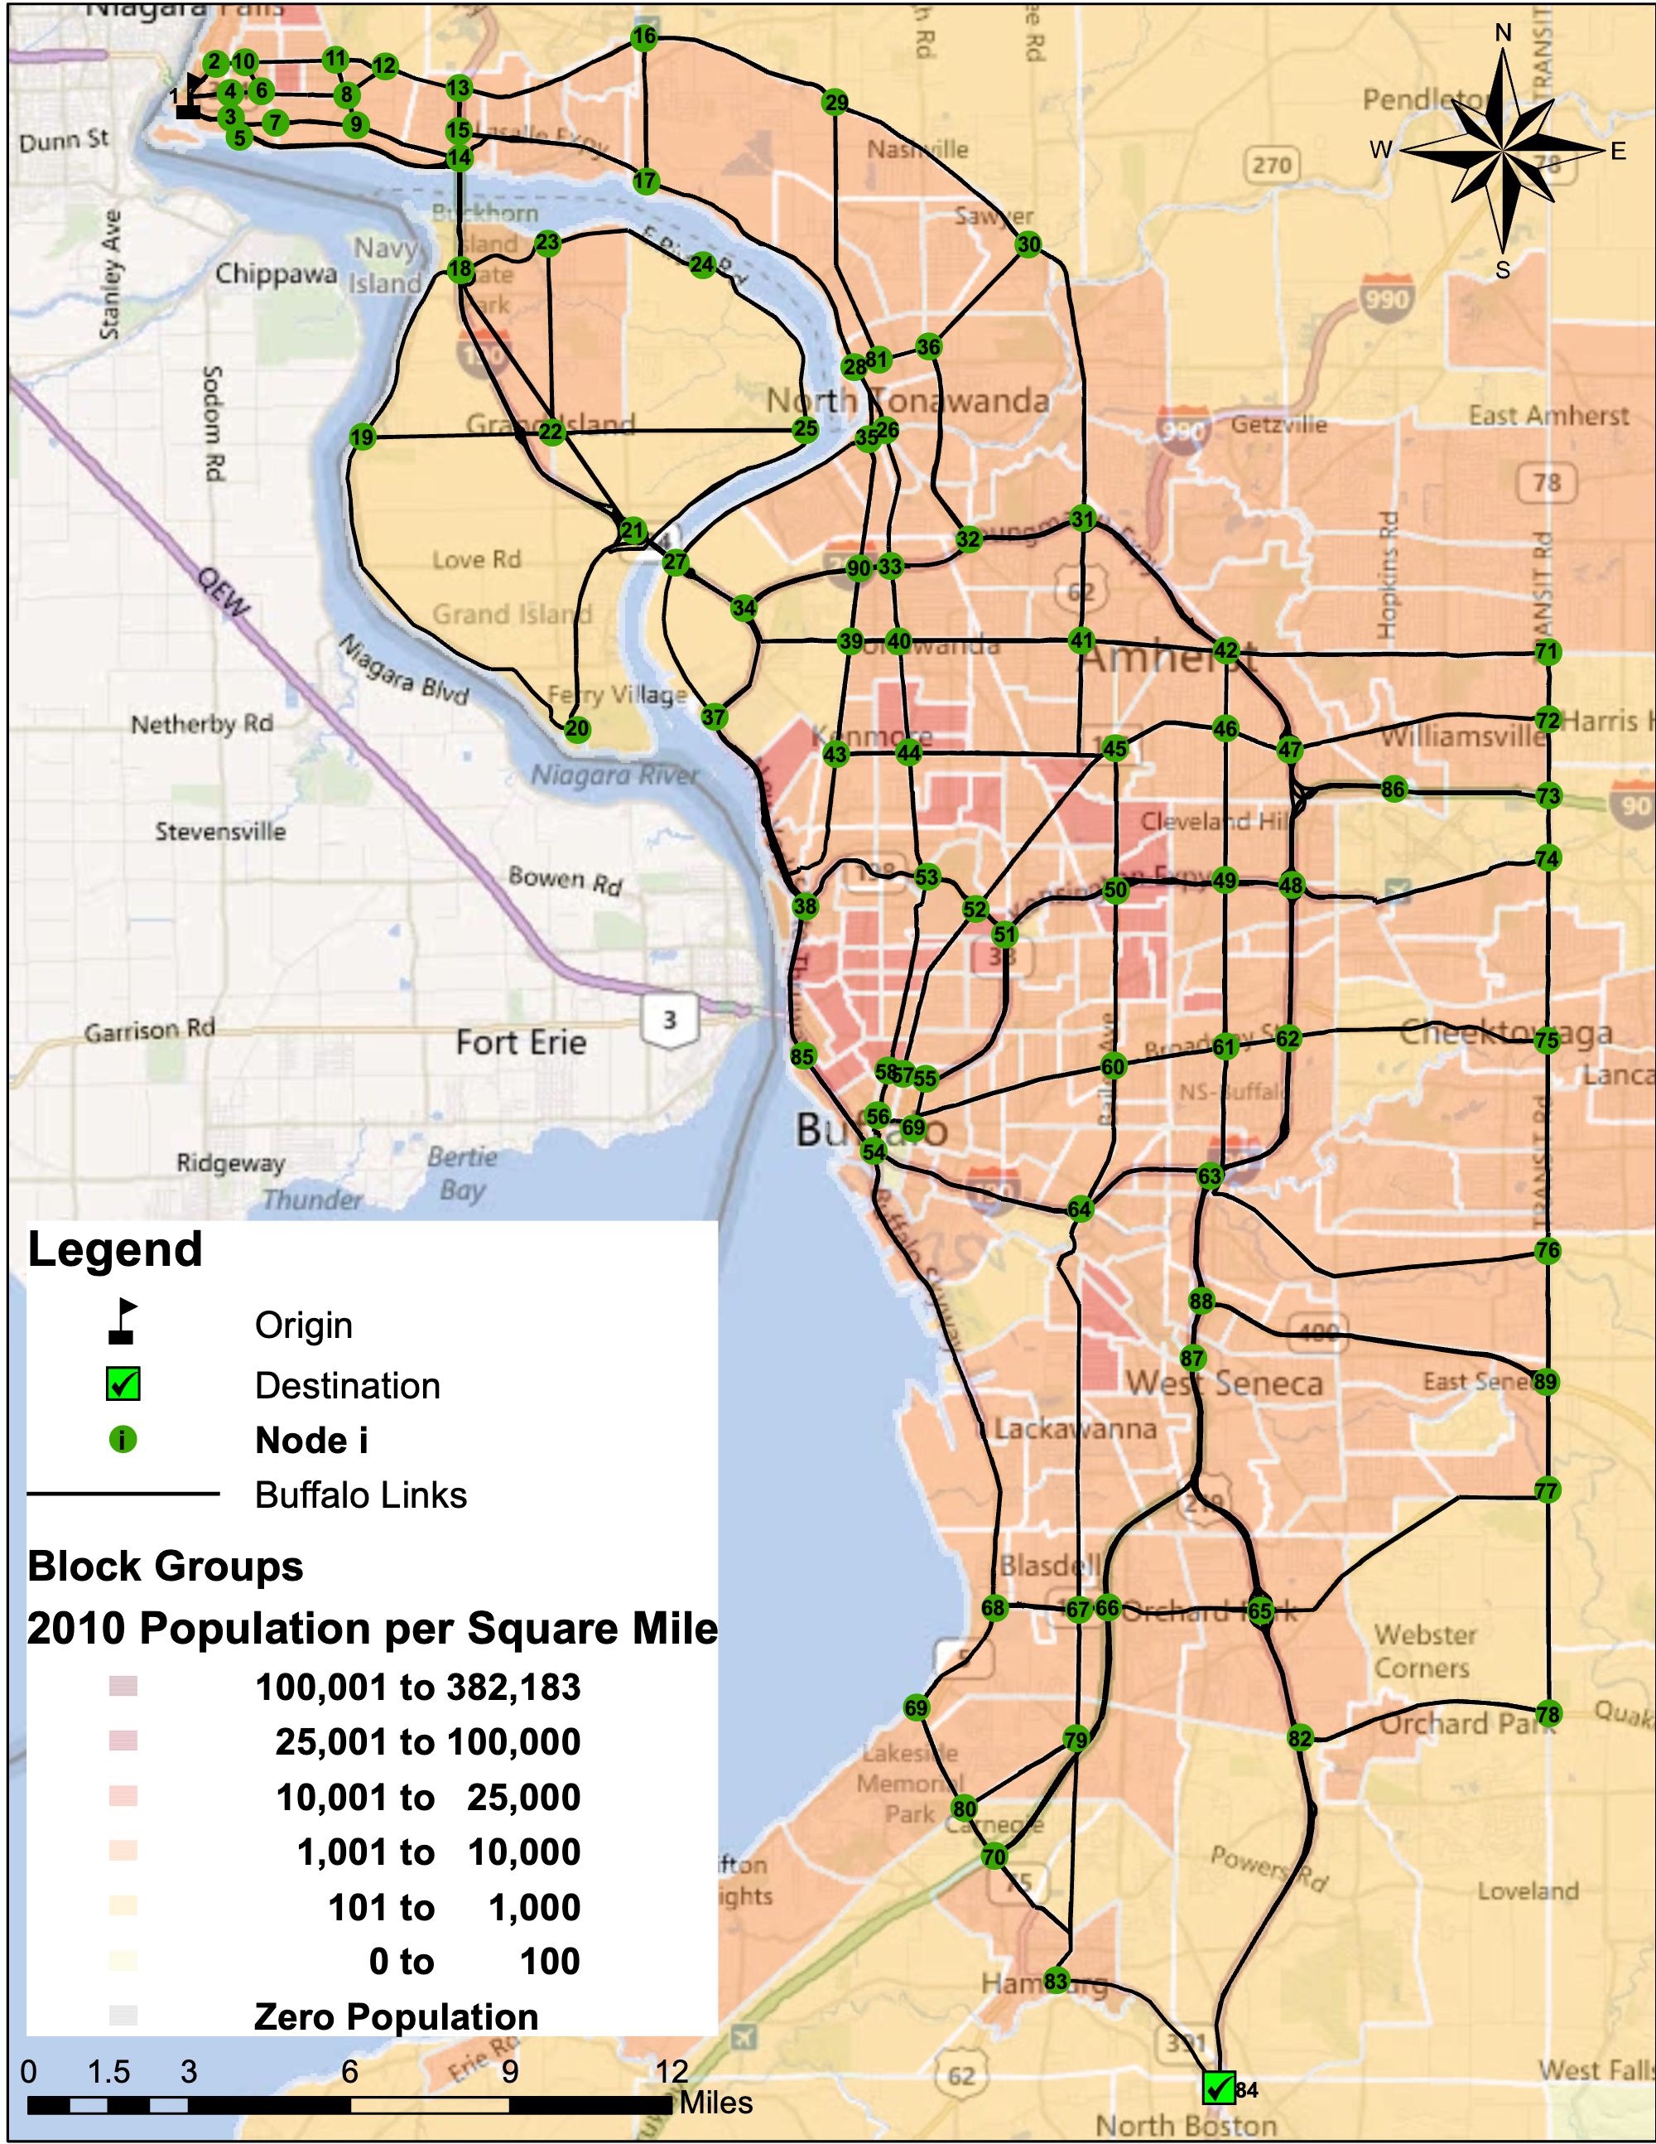
Preparation of the data
Customer Delivery Network
All the customers are represented with green nodes.
We have a total of 90 Nodes.

Slide 8
Preparation of the data
Electric Delivery Vehicle: Workhorse C-650
Class 5 electric delivery van, specifically designed for urban logistics.
Equipped with four battery packs totaling 70 kWh, offering a maximum range of ~150 miles under ideal conditions.
Fully loaded weight: 12,500 lbs (reflecting real operational loads).
Operates in dense urban environments with:
Average travel speed of 30 mph (50 km/h)
Frequent acceleration/deceleration, affecting battery consumption
The vehicle is well-suited for short-range deliveries but sensitive to external conditions like temperature, payload, and wind resistance.

Slide 9
Preparation of the data
Rolling Resistance (Friction Coefficient – f_{r})
The resistance between tires and road surface increases as temperatures drop, due to tire rubber stiffening and road texture changes.
Modeled using a temperature-dependent formula: f_{r} = 0.0118 − 0.00013 × T.
Colder climates like Buffalo (e.g., −5°C) cause a noticeable increase in energy demand, making rolling resistance a crucial factor in winter routing.
Road Slope and Elevation Effects
Route slope is calculated using start and end elevation data from Google Maps:
θ = arctan((h_{j} − h_{i}) / d_{ij})
Elevation gain (uphill) increases energy usage, while elevation loss (downhill) reduces propulsion needs.
While a truck is coming downhill, the main benefit comes from lower energy requirements during descents, helping to balance out overall consumption

Slide 10
Preparation of the data
Wind Direction & Energy Impact
Wind acts as either an aid or resistance, depending on its direction relative to the vehicle's path.
Meteorological data shows the origin of the wind, but for energy modeling we need the direction it moves toward:
Converted using: θ_{aero} = (θ_{met} + 180°) mod 360°
Ensures accurate alignment of wind data with vehicle travel bearings between customer nodes
Using historical wind data, we calculate the effective wind component with: v_{w eff} = v_{w} × cos(θ_{wind} − θ_{vehicle}).
Interpretation:
Tailwind (positive v_{w_eff}): Pushes the vehicle forward, reduces energy use
Headwind (negative v_{w_eff}): Pushes against the vehicle, increases consumption
Crosswind: Minimal effect, but may slightly influence steering energy

Slide 11
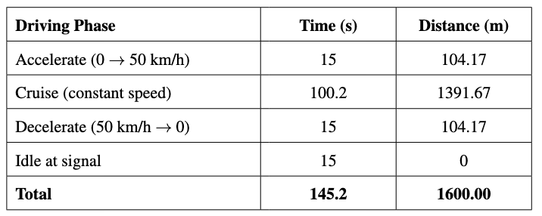
Preparation of the data
Vehicle Acceleration Patterns
In Buffalo’s urban setting, delivery vans frequently start and stop due to traffic signals and customer locations. Based on our exploration, there is approximately one traffic signal every 1.6 km (~1 mile), and the average stop time at a signal is 15 seconds.
Vehicles are modeled to accelerate from 0 to 30 mph (0 to ~50 km/h) in 12–18 seconds.
Average acceleration: 0.89 to 1.33 m/s², computed as: a = (v_{f} - v_{i}) / t.
These repeated acceleration-deceleration cycles significantly increase energy usage, especially during short deliveries.

Slide 12
Preparation of the data
Regenerative Braking Efficiency
Unlike conventional vehicles, EVs can recover kinetic energy during braking by converting it into stored battery energy. From the studies, it says that 25-40% of the energy can be recovered that is lost by applying brakes.
In urban driving (like Buffalo), frequent stops due to traffic signals, pedestrians, and short delivery intervals maximize regeneration opportunities.
However, the energy recovered is always less than what is spent during acceleration, making frequent stops net energy-negative.
Auxiliary Energy Consumption
Non-driving systems like heating, cooling, and electronics draw power directly from the battery.
Heater & AC are the largest contributors:
In cold weather (e.g., −4°C): ~0.04 kWh/km
In milder weather (~10°C): ~0.02 kWh/km

Slide 13
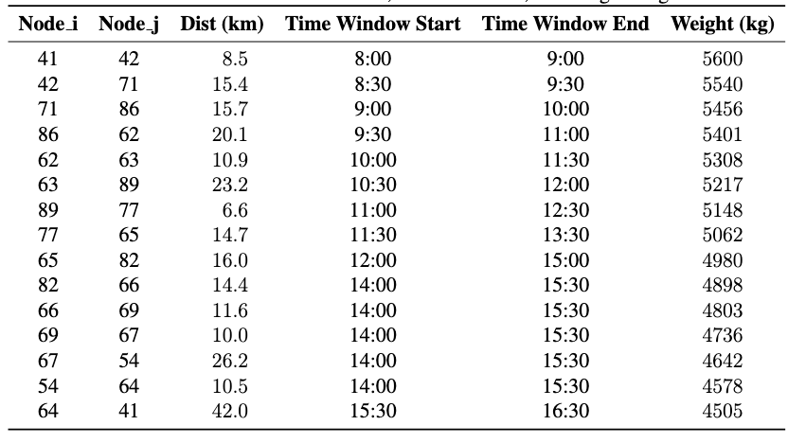
Methodology
Route Planning
The study evaluates 6 electric trucks following fixed pre-planned routes each day. Simulated across two months Feb’ 2025 (winter conditions) and Jun’ 2024 (summer conditions).
Each truck follows specific time windows per customer and drops certain weight at every customer. Truck 1’s route is predefined as below.

Slide 14
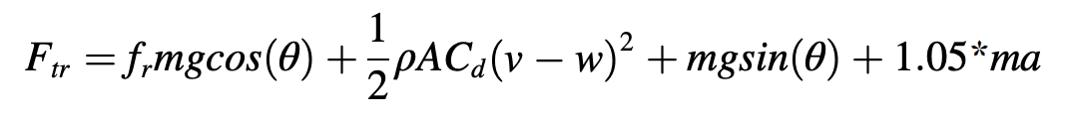
Methodology
Energy Consumption equation
Below equation gives the instantaneous force ( Tractive Force) required to move the vehicle considering all real-world resistances:
Where:
f_{r} = rolling friction coefficient
m = vehicle mass
g = gravitational constant
θ = road slope angle
ρ = air density
A = frontal area
C_{d} = drag coefficient
v = vehicle speed
w = wind speed in vehicle direction
a = vehicle acceleration
1.05 accounts for inertial drivetrain losses

Slide 15
Methodology
Energy Consumption equation
To convert force into energy, we compute the work done per second and adjust for powertrain efficiency and auxiliary consumption:
Powertrain efficiency (η) = 85%, and auxiliary energy consumption is modeled based on ambient temperature.

Slide 16
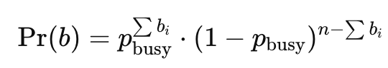
Methodology
Charging Station Simulation – Queue Logic
In reality, EV drivers can check which charging ports are available using mobile apps. However, our simulation doesn’t have live data, so we needed a probabilistic model to simulate charging station behavior.
We define a random variable p_busy ∈ [0, 1] that captures the probability any single port is occupied when a vehicle arrives at the station.
Assume the station has n ports. Each port is treated as independently busy.
Let b ∈ {0, 1}^{^n} be a binary vector where:
bᵢ = 1 → port i is busy
bᵢ = 0 → port i is free
Then, the probability of a specific pattern b occurring is:
Where:
∑bi​ = total number of busy ports in pattern b
We compute cumulative probabilities over all 2^n patterns and draw one using random sampling.

Slide 17
Methodology
Charging Station Simulation – Queue Logic
If at least one port is free → Queue Time=0.
If all ports are busy → Queue time is sampled as:
t_{queue} ​∼ random(0,30) minutes
This models wait time until a charging slot becomes available based on real-world fast-charger usage data.
Once charging begins:
Charging rate is 2 kWh/min
Battery refill time: tcharge=Eneeded/2
Where Eneeded= 0.8* Battery Capacity−Current Battery Level
t_{total}​=t_{queue}​+t_{charge}

Slide 18
Methodology
Time Window Compliance Monitoring
For each of the 6 trucks, the simulation monitors delivery arrival times vs. the customer’s scheduled time window.
Delivery is compliant if arrival falls within [time_window_start, time_window_ end] range.
Results are reported:
Per delivery
Per day
Overall monthly compliance %
Time window violations are expected to increase in February due to colder temperatures, rerouting for charging, and wind conditions.
This metric allows a quantitative assessment of delivery reliability.

Slide 19
Methodology
Depot Return Heuristic – Ensuring On-Time Completion
Objective: All 6 electric trucks must return to the depot no later than 17:00, aligning with the end of the delivery agents’ shift.
What if a route exceeds the return time?
We implement a minimal customer removal heuristic to restore time feasibility while retaining as many deliveries as possible.
How it works:
Start with the original route of the truck visiting all N customers.
Simulate depot return time. If it exceeds 17:00:
Try removing one customer at a time and re-run the simulation.
If that’s not enough, evaluate combinations of two, then three, and so on.
Stop as soon as the route becomes feasible (returns by 17:00).
Removal Preference
Choose the customer (or combination) whose removal results in:
The earliest depot return, and
The fewest total customer drops

Slide 20
Methodology
Reassigning Dropped Customers
Customers dropped from the main 6 trucks daily due to return-time constraints are reassigned for delivery.
Two-phase recovery plan:
Phase 1: Single-Truck Attempt
All dropped customers are sequenced in one truck’s route
The route is simulated from depot → all customers → depot
If the truck can return by 17:00, the plan is accepted
Phase 2: Two-Truck Split
If a single truck can’t finish, divide customers into two groups (S1 & S2)
Each group assigned to a separate truck
Choose the split where both trucks return on time and total delivery time is minimized

Slide 21
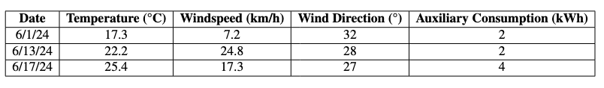
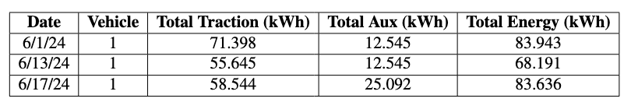
Results
Impact of Weather on Energy Consumption
Wind and temperature impacts energy consumption and performance for an electric vehicle. To see the impact, three different days were analyzed. Below is the weather data for the three days.
Below is the energy consumption for those three days.

Slide 22
Results
Impact of Weather on Energy Consumption
Low Wind, Higher Energy Use (June 1st ):
Wind speed was low (7.2 km/h).
The vehicle used 71.39 kWh just for driving (tractive energy).
Since temperatures were mild (17.3°C), the extra energy for cooling/heating (auxillary load) stayed low.
High Wind, Less Energy for Driving (June 13th & 17th ):
On June 13th, wind speeds jumped to 24.8 km/h, and on June 17th , they were 17.3km/h.
Surprisingly, the vehicle needed less energy to drive (55.64 kWh and 58.54 kWh, respectively) compared to June 1st.
This suggests strong winds might have helped push the vehicle, reducing effort.
But Total Energy Stayed Similar - Here’s Why:
Even though driving energy dropped on windy days, the total energy used didn’t change much.
On June 17th, temperatures rose to 25.4°C, so the vehicle needed more cooling, increasing auxiliary energy use.

Slide 23
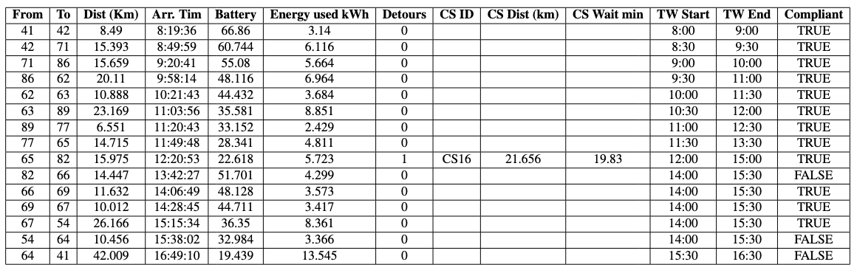
Results
Impact on Time Window Compliance
Route details captured for Truck 1 on 6/1/2024 with distance, energy used, charging detours, and time window compliance.
15 stops completed, with 12 on-time deliveries (80% compliance).
One charging detour occurred at CS16 with a ~19-minute wait.

Slide 24
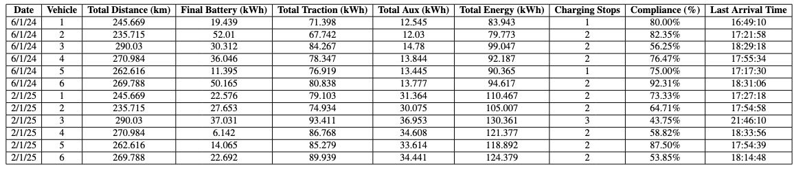
Results
Impact on Time Window Compliance
Over a 58-day simulation with 6 trucks, the average delivery compliance was 74%.
Colder months (Feb) saw lower compliance (68.38%) compared to June (79.25%).
Higher auxiliary loads in winter (e.g., 31–36 kWh for heating) increased total energy use.
Frequent rerouting and energy-intensive cabin comfort systems delayed return to depot (some trucks after 19:00).
Main takeaway: Weather extremes (cold) and charging delays significantly impact on-time delivery performance.

Slide 25
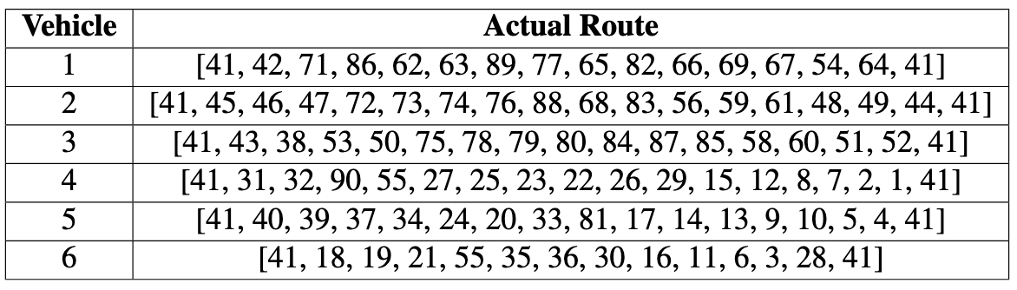
Results
Customer Removal
Out of 12 vehicle-day entries, only Vehicle 1 on 6/1/24 is able to return to depot before 17:00 without route changes. Refer to the picture in the previous slide.
All other vehicles required route modifications to ensure timely return
This confirms the need for a route adjustment strategy to balance delivery coverage and operational time limits.
Table on the right describes the actual route for all 6 trucks.

Slide 26
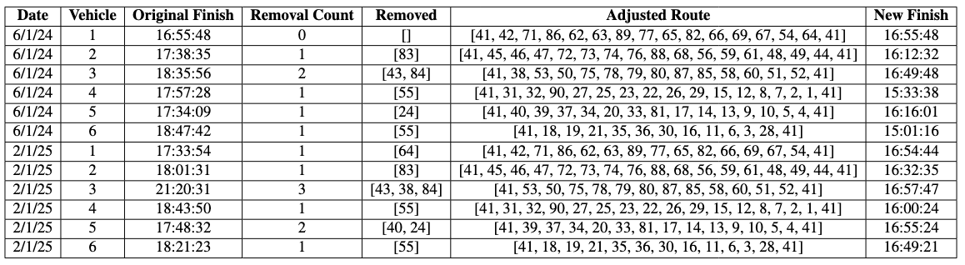
Results
Customer removal
Focusing on Vehicle 2 on 6/1/2024, customer 83 was removed from the original route. Initially, the route sequence included nodes 68–83–56, covering a total distance of approximately 63.96 kilometers. Refer to the previous slide.
After removing customer 83, the adjusted route became 68–56, reducing the segment distance to just 23.07 kilometers.
This elimination resulted in a significant reduction of nearly 40 kilometers, which contributed directly to a substantial improvement in the vehicle’s final arrival time.

Slide 27
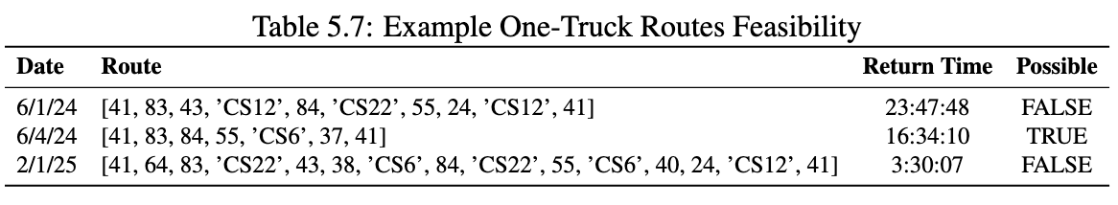
Results
Single Truck Feasibility
Some delivery schedules are too long for a single vehicle to complete before the 5 PM (17:00) cutoff, even after pruning and rerouting.
Analysis was done to evaluate which days/routes are feasible with just one truck.
On Jun’1st and Feb’1st route was not completed by 5 PM and was late by 6 hours and 10 hours, but on Jun’4th it was completed on time.

Slide 28

Results
Two-Truck Feasibility
Single-truck routes on 6/1/2024 and 2/1/2025 failed to meet the 17:00 depot return deadline even after customer pruning and rerouting.
A two-truck model was evaluated to redistribute customer stops, optimize energy and time, and minimize total operation time.
June 1, 2024
Truck 1: 41 → 43 → 24 → 55 → 41 — returned at 11:47
Truck 2: 41 → 83 → 84 → 41 — returned at 13:19
Total duration: 546.6 min — well within deadline
February 1, 2025
Truck 1: 41 → 64 → 83 → CS22 → 84 → 55 → 41 — 15:16
Truck 2: 41 → 43 → 38 → 40 → 24 → 41 — 11:18
Total duration: 634.7 min — meets cutoff

Slide 29
Future work
Dynamic Traffic Modeling
Current model assumes static drive times for all road segments
Ignores peak hour traffic patterns (morning, midday, evening)
Improvement: Integrate time-dependent travel-time curves
Use real-time feeds or historical traffic datasets
Result: More accurate predictions for arrival times and energy consumption
Empirical Charging Station Queues
Current logic uses uniform random busy probability for charging port wait times
Assumes all stations behave similarly – not realistic
Suggested improvement:
Fit Poisson or nonstationary queueing models to station usage data
Model wait times by day of week & time of day.
Result: Enables data-driven, location-specific wait time forecasting
Smarter Customer Removal & Fleet Optimization
Current method removes customers only to meet depot return cutoff.
Misses nuanced opportunities to optimize schedule without needing a second truck.
Proposed strategy:
Evaluate impact of each customer removal on return time and overall fleet utilization
Balance benefit of on-time return vs. cost of deploying extra trucks
Goal: Minimize total fleet time while maximizing on-time delivery compliance

Slide 30
Thank you!

